Slide 1
Lessons Learned Introduction
Date: 2019/1/4

Slide 2
Lessons Learned
Lessons Learned

Slide 3
Purpose and Scope
[Lessons Learned]
目的:
經由分享各開發處產品設計曾經發生過的重大問題與解決該問題的經驗來避免開發人員重複發生重複學習的過程
範圍:
收集產品開發期間或量產後所經歷重大問題與解決過程的經驗或是具有代表性的問題與解決方法

Slide 4
LL Process Flow
重大問題結案 產生 FA/CA Report
確認申請資料內容完整正確?
(申請者)
資料修改
(申請者)
部門內討論是否提出LL
?
(部門主管)
資料修改或放棄申請?
最終核決結果?
(部門主管)
(RD Head)
不申請加入LL Database
(RD Head)
不申請加入LL Database
編號並新增至LL Database
填寫LL database Excel表單資料,提供FA/CA Report
(PLM/助理)
公告通知所有開發處人員
(申請者)
(PLM/助理)

Slide 5
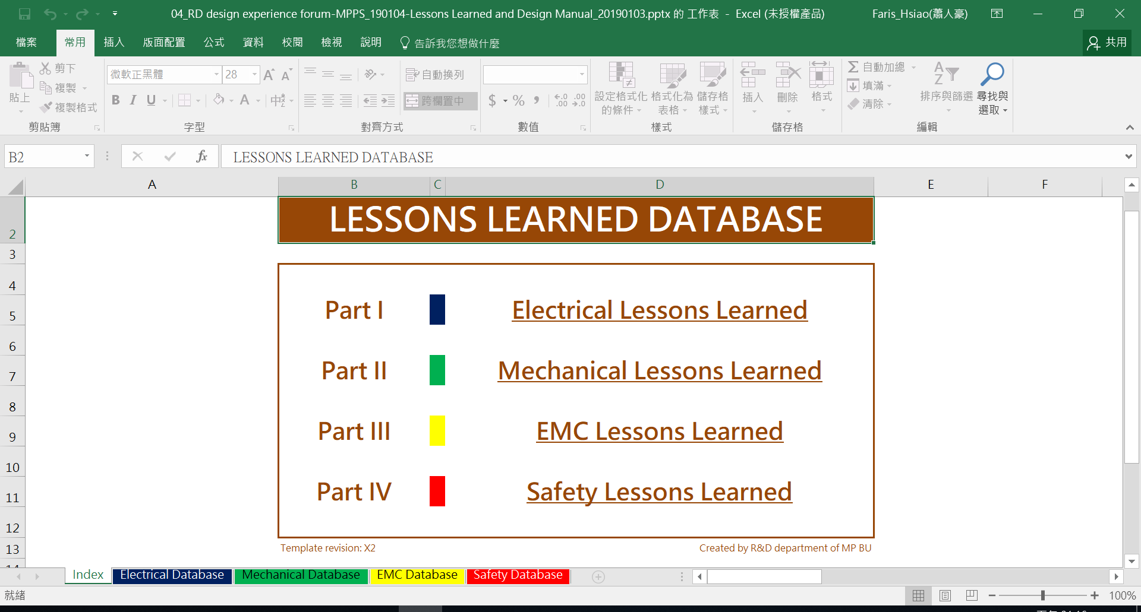
Lessons Learned Templates
[Lessons Learned Database Template]

Slide 6
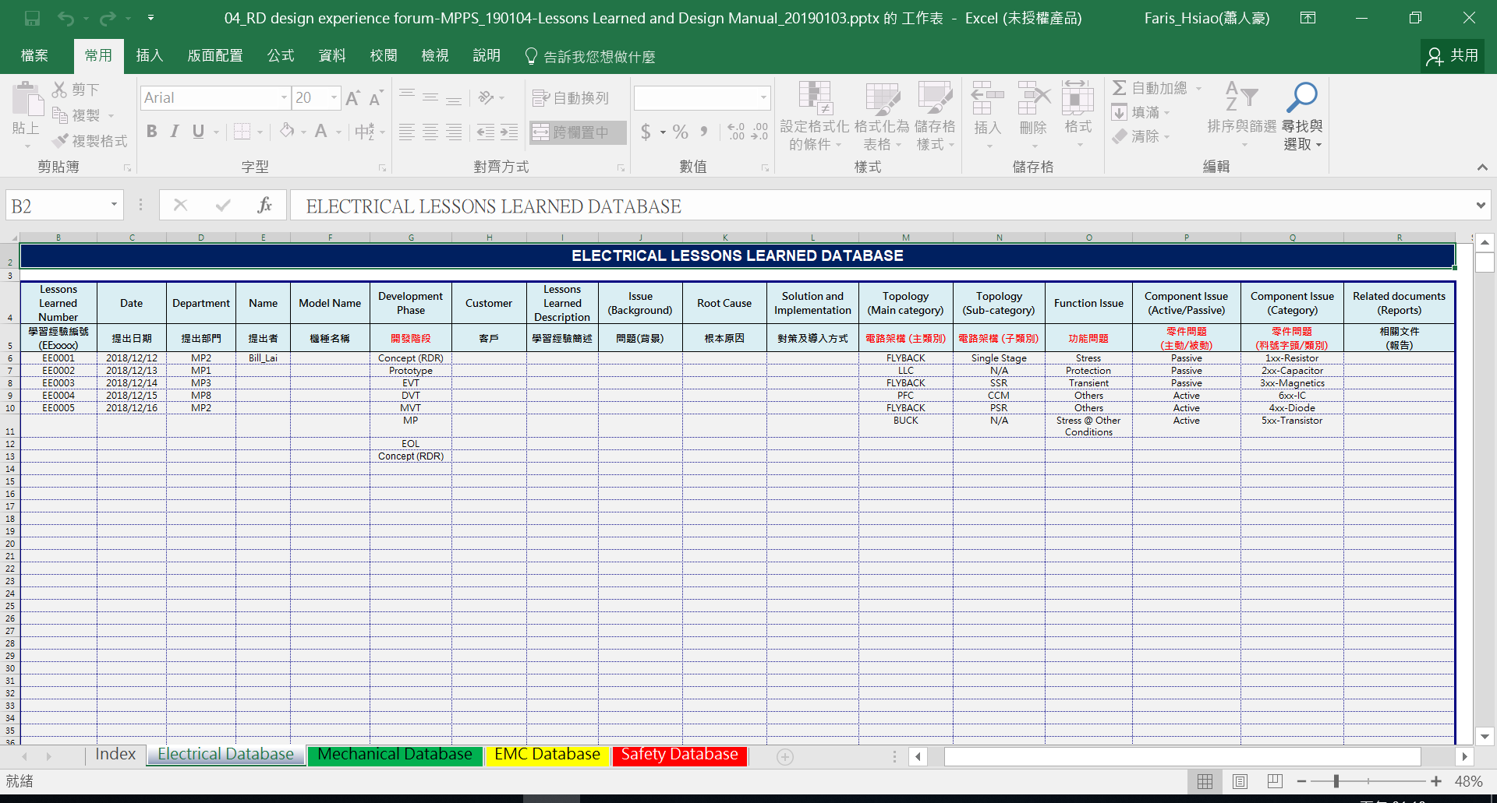
Lessons Learned Templates
[Lessons Learned Database Template]

Slide 7
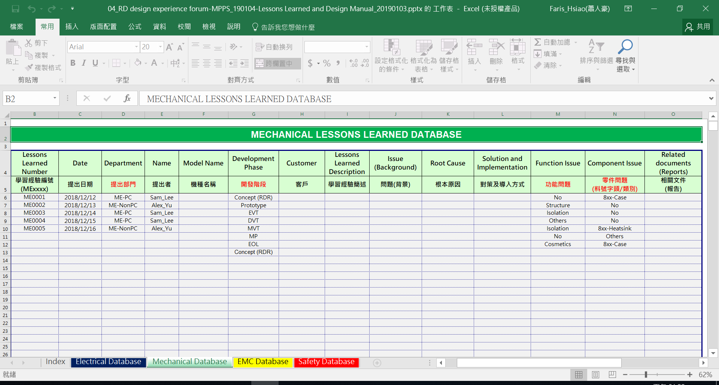
Lessons Learned Templates
[Lessons Learned Database Template]

Slide 8
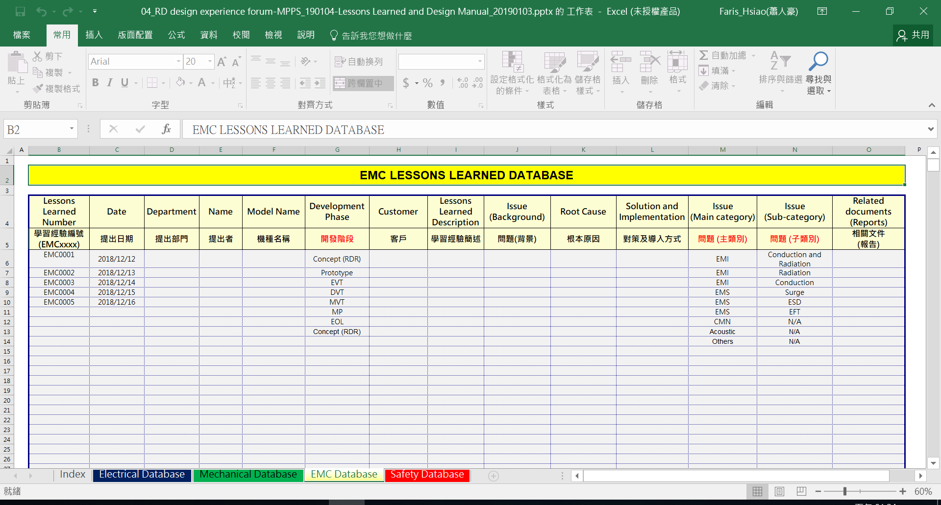
Lessons Learned Templates
[Lessons Learned Database Template]

Slide 9
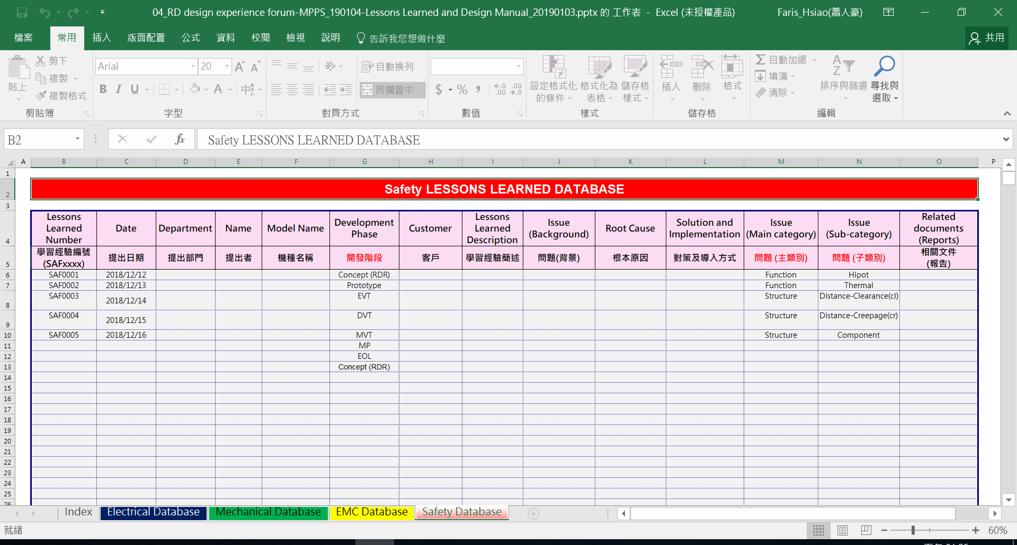
Lessons Learned Templates
[Lessons Learned Database Template]

Slide 10
Lessons Learned Database Categories
Lessons Learned Database
Electrical
Mechanical
EMC
Safety
DCM
Cosmetics
PFC
CCM
Hipot
LLC
Function
Structure
Function
Thermal
Topology
PSR
FLYBACK
SSR
Isolation
Structure
Distance-Clearance(cl)
Single Stage
Others
BUCK
Distance-Creepage(cr)
8xx-Case
Stress
Protection
7xx-Cable
Component
Transient
Component
8xx-Label
Function
Protection
Others
8xx-Shielding
Transient
8xx-Heatsink
Others
1xx-Resistor
Others
Conduction & Radiation
Passive
2xx-Capacitor
Conduction
3xx-Magnetics
EMI
Radiation
Component
9xx-PCB
EMS
Surge
4xx-Diode
CMN
ESD
Active
5xx-Transistor
Acoustic
EFT
6xx-IC
Others

Slide 11
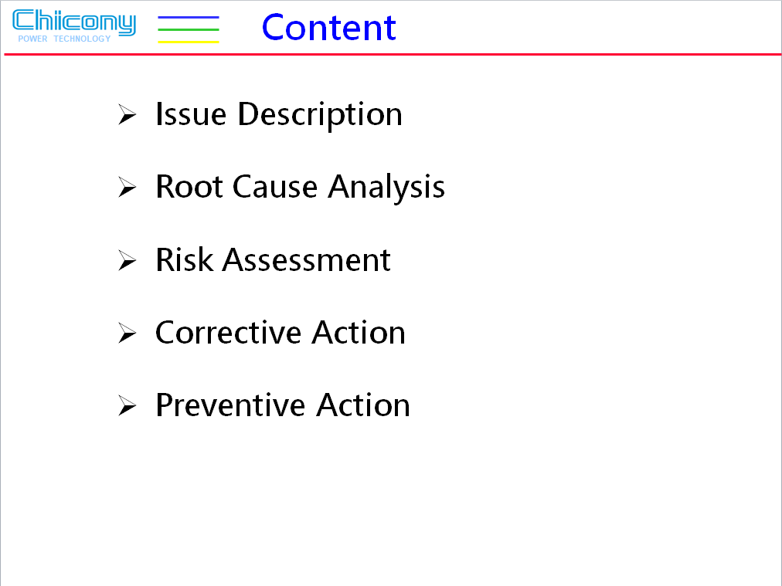
FA/CA Template
[FA/CA Template]

